Slide 1


Parity Measurements on Weakly Coupled Carbon Spins in Diamond
Michiel Adriaan Rol
Supervisors :
Ir. J.Cramer
Dr. Ir. T.H. Taminiau
Prof. Dr. Ir. R. Hanson
Performed at:
Quantum Transport group
Kavli Institute of Nanoscience
Delft University of Technology

Slide 2


Parity Measurements on Weakly Coupled Carbon Spins in Diamond
Master Thesis Presentation Adriaan Rol
Short Introduction to Quantum Information
Control over electron spin
Extending coherence
Control over single carbons
Entanglement by parity measurement
Quantum error correction

Slide 3


A Quantum Computer promises an exponential speedup over conventional computers
Quantum Information
Figure from The Economist: Quantum Computing feb 25th 2012

Slide 4
A quantum computer uses qubits, the quantum analogue of the classical bit
Classical Bits vs Quantum Bits
Bit
Qubit
0
1

Slide 5
Single qubits can be represented by an arrow on the Bloch-sphere
Bloch sphere
Single qubits can be represented by arrows
Measurements project
Qubits are fragile
Qubits can entangle

Slide 6
The state after a measurement is what you measure it to be
Projective measurements
Measurement outcome
State after measurement
Single qubits can be represented by arrows
0
1
Measurements project
Qubits are fragile
0
or
Qubits can entangle
1

Slide 7
Two particles are entanglent if they cannot be described independtly of each other
Entanglement
Single qubits can be represented by arrows
A
B
Measurements project
Qubits can entangle
1
0
0
1
0
1
1
0
1
0
1
1
0
1
0
0
1
0
A
B
Qubits can entangle

Slide 8
Qubits are fragile
Decoherence
Single qubits can be represented by arrows
Measurements project
Qubits can entangle
Qubits are fragile

Slide 9
Qubits differ from normal bits on four important characteristics
Summary quantum bits
Single qubits can be represented by arrows
Measurements project
Qubits can entangle
A
B
Qubits are fragile

Slide 10
Quantum Error Correction is essential in building a scalable quantum computer
Error Correction
Classical Error Correction
Quantum Error Correction ?
Make n copies of the bit
An error occurs
Every bit is measured and a majority vote determines what the original bit was
1
11111111
11101111
1
No Cloning Theorem
Make n copies of the qubit
An error occurs
Every qubit is measured and a majority vote determines what the original bit was
Measurements project
Notes:
Classical -> Errors Average out
Quantum -> Errors add up

Slide 11
A Parity measurement measures if two qubits point in the same direction
Parity measurement
Notes:
Go over examples,
Let audience guess what the outcome will be
Explain that it also works on entangled states.

Slide 12
By measuring the parity an Error can be diagnosed and corrected
3-qubit quantum error correction
Encode state on a logical qubit consisting of an entangled state of multiple qubits
An error has occurred
Perform parity measurements to diagnose the error
Correct the error

Slide 13
Parity Measurements on Weakly Coupled Carbon Spins in Diamond
Master Thesis Presentation Adriaan Rol
Short Introduction to Quantum Information
Control over electron spin
Extending coherence
Control over single carbons
Entanglement by parity measurement
Quantum error correction
Notes:
Red circle:
Coupling strength determines how fast we can address.
Closer is stronger coupling. Must be faster than decoherence of the electronic spin.
Red line is boundary set by T2*
Within Strongly coupled
Outside Weakly coupled
Few within coherence
Animation 1 laser pulse: -> Dephasing of close by spins.
Few strongly coupled
Conclusion, we need to extend coherence to be able to address stronger coupled.
We Address Weakly Coupled Carbons in order to find enough suitable qubits

Slide 14

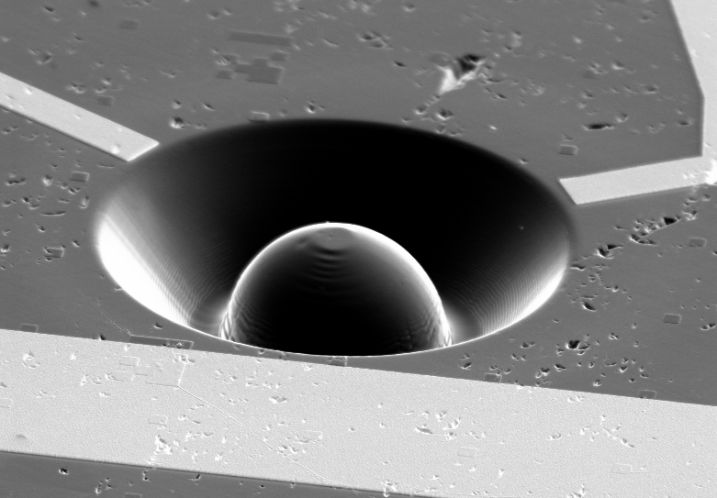
The NV-center is an impurity in Diamond of which we can contol the electronic spin
Introduction to the NV-center
The electronic spin can be read out with a laser pulse
The electronic spin can be rotated with microwave pulses
Notes:
Slide Showing optical Readout
Arrow up -> photon out
Arrow down-> no response
MW control, can turn purple spin around. (rotate the spin).

Slide 15
Parity Measurements on Weakly Coupled Carbon Spins in Diamond
Master Thesis Presentation Adriaan Rol
Short Introduction to Quantum Information
Control over electron spin
Extending coherence
Control over single carbons
Entanglement by parity measurement
Quantum error correction
Notes:
Red circle:
Coupling strength determines how fast we can address.
Closer is stronger coupling. Must be faster than decoherence of the electronic spin.
Red line is boundary set by T2*
Within Strongly coupled
Outside Weakly coupled
Few within coherence
Animation 1 laser pulse: -> Dephasing of close by spins.
Few strongly coupled
Conclusion, we need to extend coherence to be able to address stronger coupled.
We Address Weakly Coupled Carbons in order to find enough suitable qubits

Slide 16
We can measure the coherence time trough a ramsey experiment
Ramsey Experiment

Slide 17
Coherence can be extended by applying a pi-pulse
Spin-Echo

Slide 18
Coherence can be extended further by applying more pi-pulses
Dynamical Decoupling
x 240 !
Source: De Lange et al. Science (2010) DOI: 10.1126/science.1192739
Notes:
TDD > 40 ms was measured at N = 256 pulses, no end in sight yet.

Slide 19
Parity Measurements on Weakly Coupled Carbon Spins in Diamond
Master Thesis Presentation Adriaan Rol
Short Introduction to Quantum Information
Control over electron spin
Extending coherence
Control over single carbons
Entanglement by parity measurement
Quantum error correction
Notes:
Animatie: Dynamical decoupling
1 –pulse -> stuk groter
meerdere keren heen en weer bewegen -> Cirkel wordt stuk groter

Slide 20
Carbons rotate around different axes depending on the electron state
Notes:
Hyperfine interaction present for ms = +1, not present for ms=0

Slide 21


By repeatedly flipping the electron spin with careful timing we can control the carbon spin
not on resonance
precisely on resonance
By precisely calibrating N and τ a conditional x rotation can be applied to a carbon spin

Slide 22
Using the control over the carbon and electron spin we can initialize carbons
Single qubit initialization
Initialization into
Initialization into

Slide 23
Parity Measurements on Weakly Coupled Carbon Spins in Diamond
Master Thesis Presentation Adriaan Rol
Short Introduction to Quantum Information
Control over electron spin
Long enough coherence
Control over single carbons
Entanglement by parity measurement
Quantum error correction
Notes:
Animatie: Dynamical decoupling
1 –pulse -> stuk groter
meerdere keren heen en weer bewegen -> Cirkel wordt stuk groter

Slide 24
Parity Measurements on Weakly Coupled Carbon Spins in Diamond
Master Thesis Presentation Adriaan Rol
Short Introduction to Quantum Information
Control over electron spin
Long enough coherence
Control over single carbons
Entanglement by parity measurement
Quantum error correction
Notes:
Animatie: Dynamical decoupling
1 –pulse -> stuk groter
meerdere keren heen en weer bewegen -> Cirkel wordt stuk groter

Slide 25
We Perform a Parity Measurement by Mapping the State of the Carbon on the electron
Requires entanglement

Slide 26
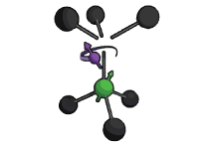
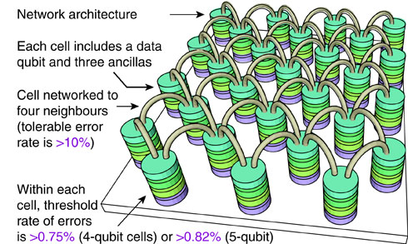
NV-centers are unique in the combination of solid state spins with an optical interface
Node-based architecture

Slide 28
In Order to Implement Quantum Error Correction we need to be correct the outcome of a parity measurement

Slide 29
Parity Measurements on Weakly Coupled Carbon Spins in Diamond
Michiel Adriaan Rol
Supervisors :
Ir. J.Cramer
Dr. Ir. T.H. Taminiau
Prof. Dr. Ir. R. Hanson
Performed at:
Quantum Transport group
Kavli Institute of Nanoscience
Delft University of Technology

Slide 30
Different NV-centers can be linked together using the optical interface
Teleportation and distant entanglement
Unconditional quantum teleportation between diamond spins over 3m
Bernien et al. Nature 497, 86 (2013);
Pfaff et al. Science 345, 532 (2014)

Slide 31
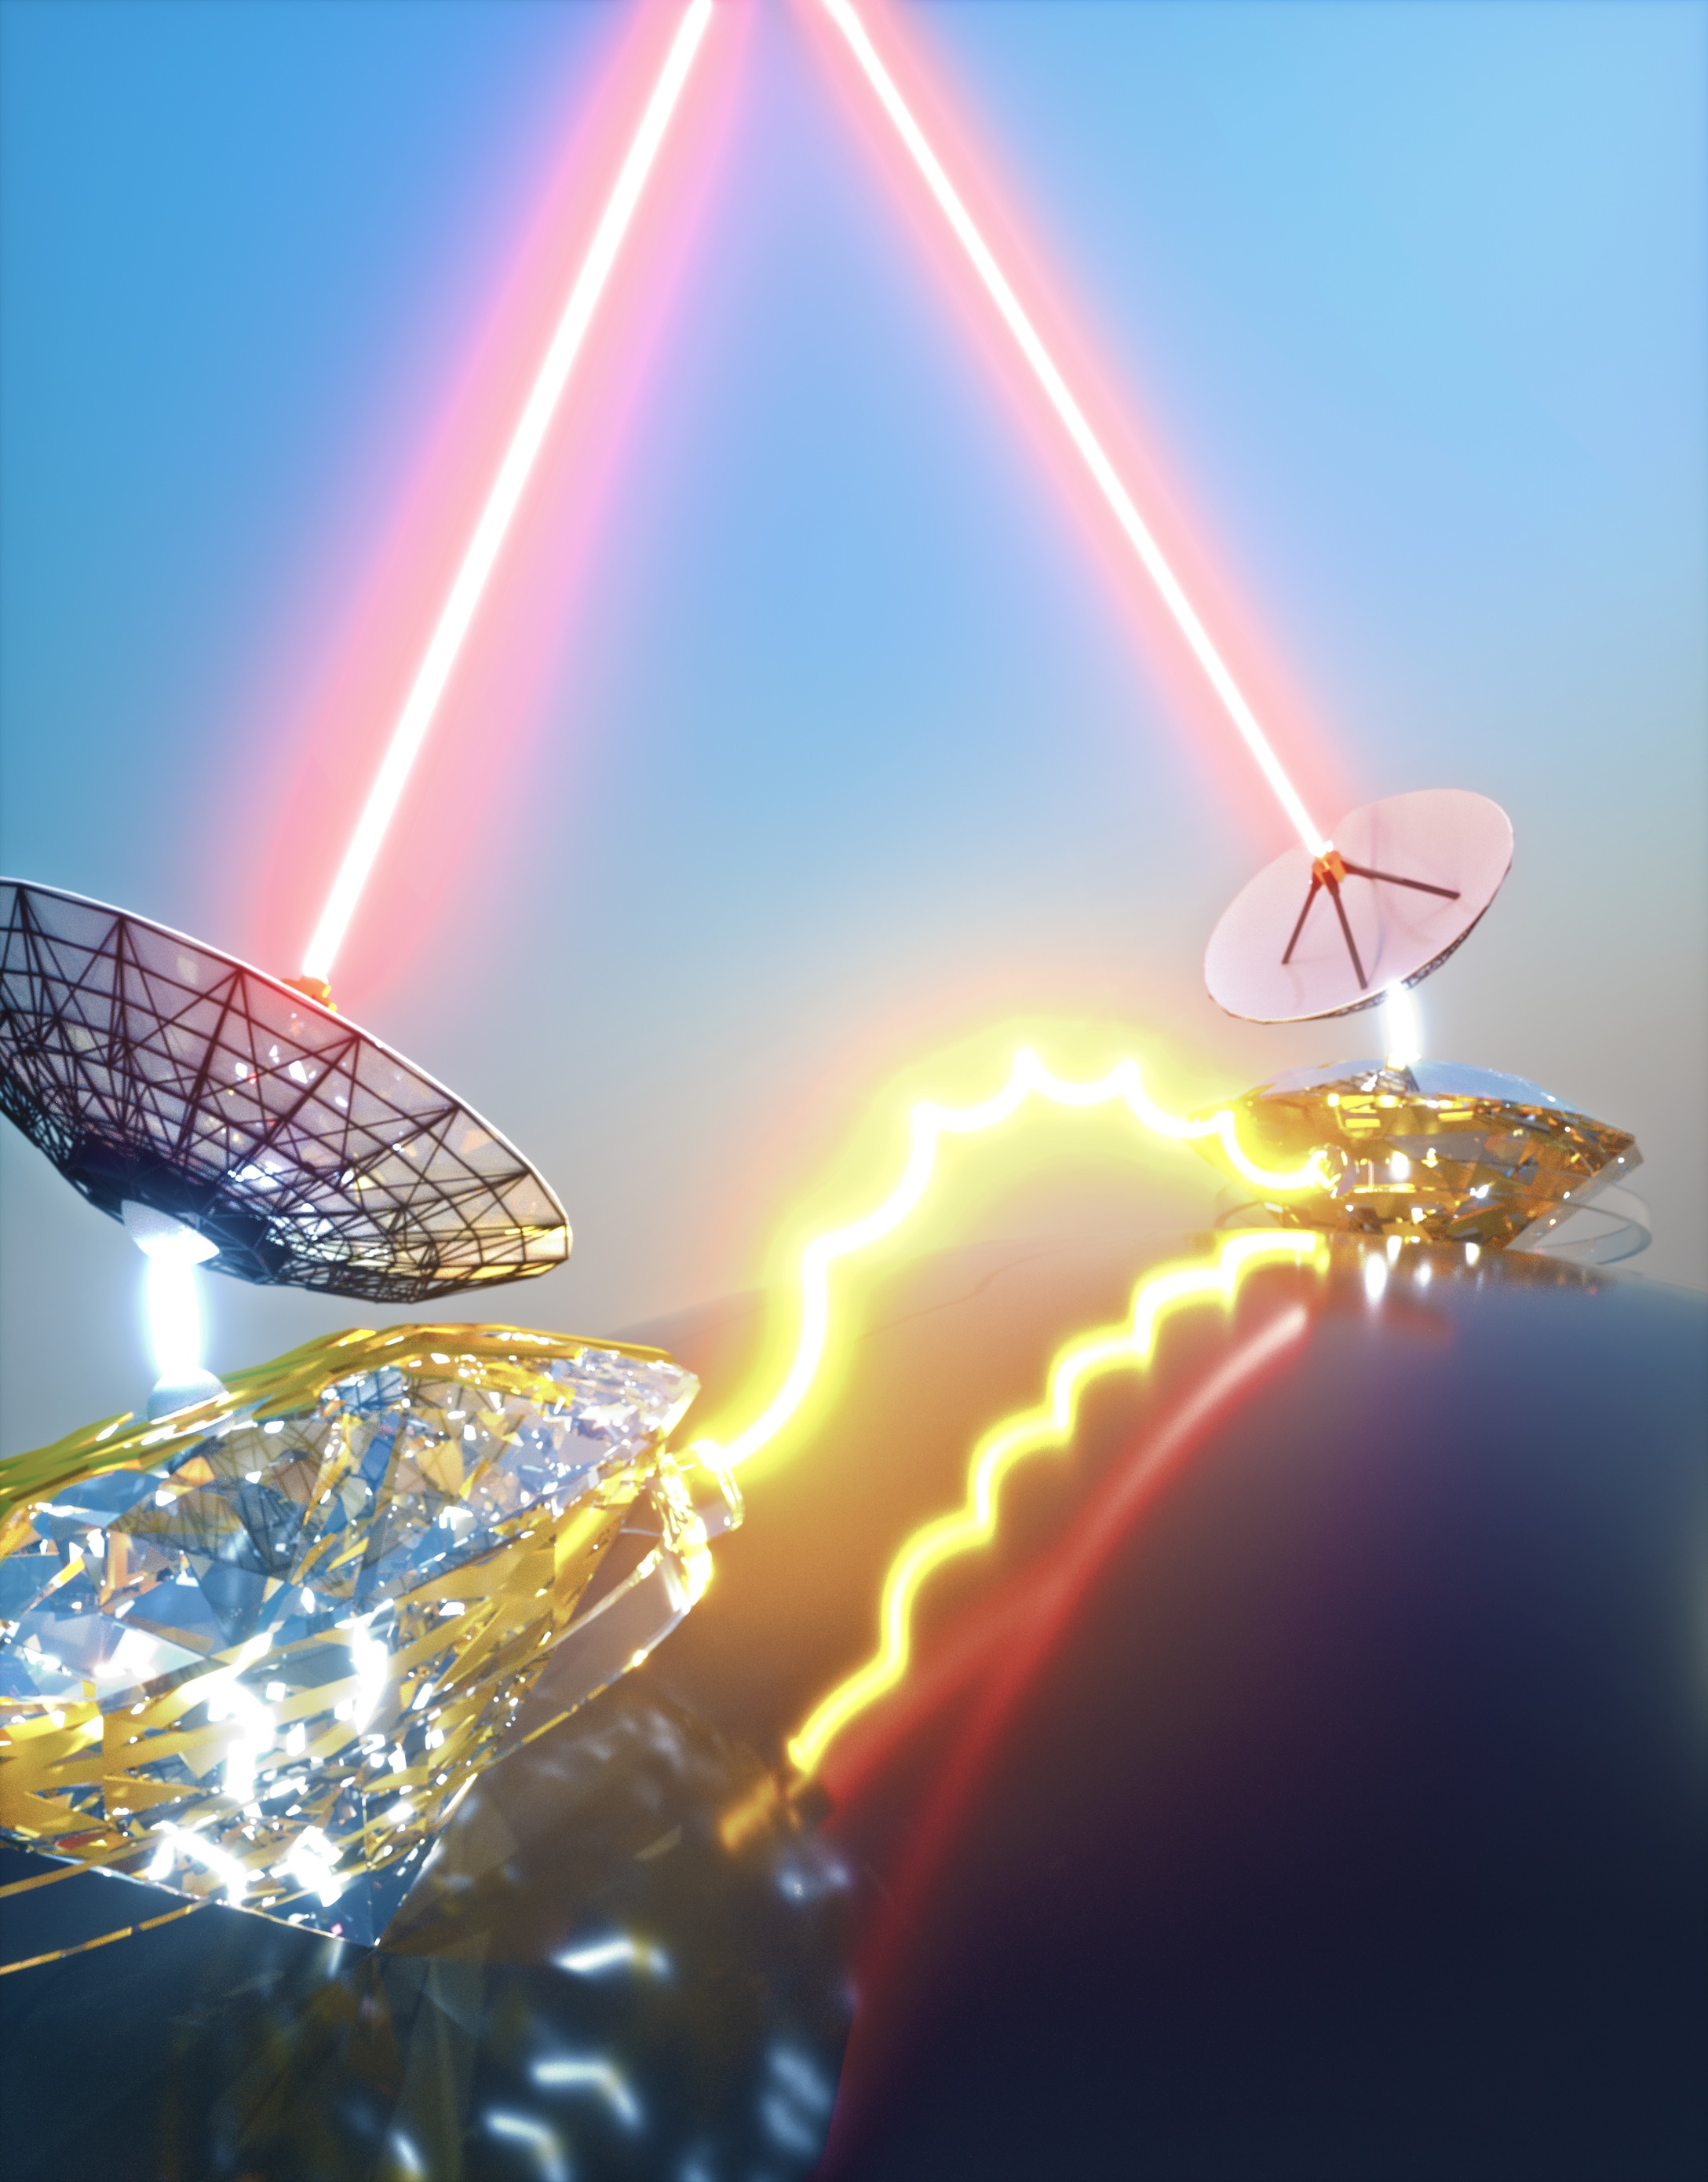
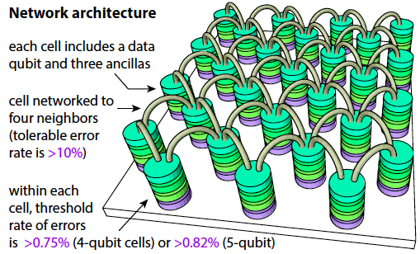
The unique combination of local spin control with an optical interface allows
Long-term motivation
Quantum Internet
Surface code quantum computing
Secure quantum communication
Quantum cloud computing
Nickerson, Li, Benjamin,
Nature Communication 2013
Barz et al., Science 2012
Notes:
31

Slide 32
Using dynamical decoupling we are able to initialize and readout a carbon spin
Might be too detailed for this presentation. Is it needed?

Slide 33
What spins are addressable?
How do you find which spins are addressable ?

